Slide 1
Big Mountain Ski Resort
New Pricing Strategy
By: Alfredo Hernandez

Slide 2
Problem
Current:
The resort currently uses a pricing strategy of charging a premium above the average price of resorts in its market segment.
Target:
We believe there is an opportunity to upgrade our pricing strategy using the value perception of all the features the resort has to offer, given the fact that the resort is well above average in most features that make a ski resort desirable.

Slide 3
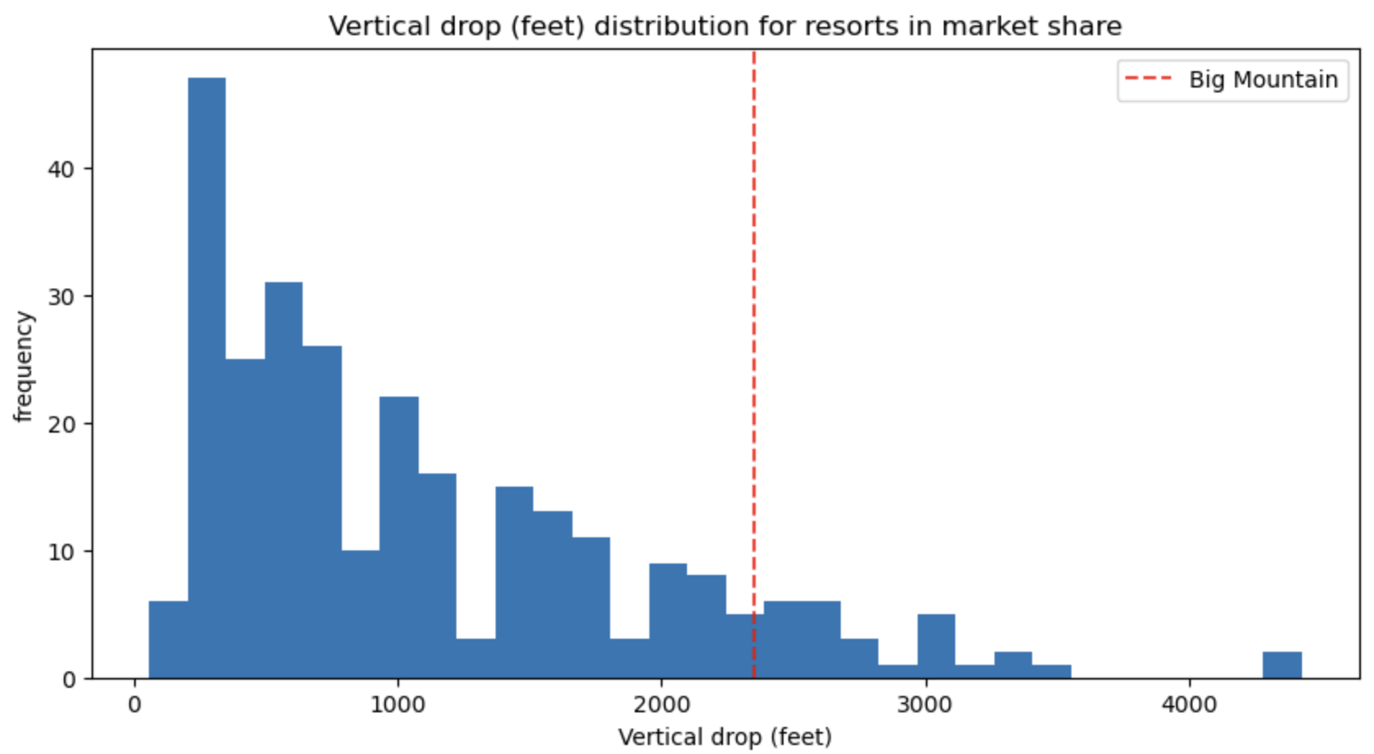
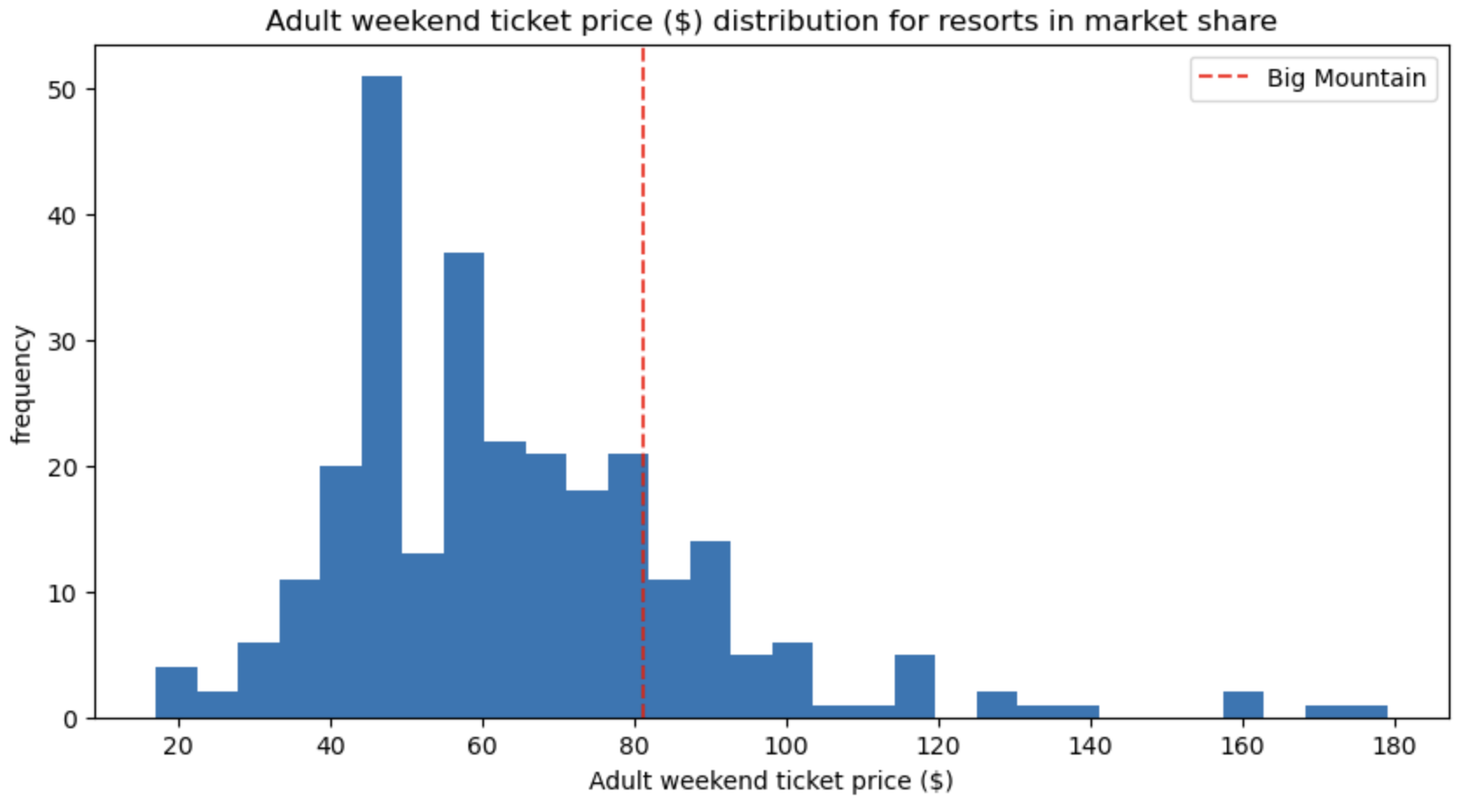
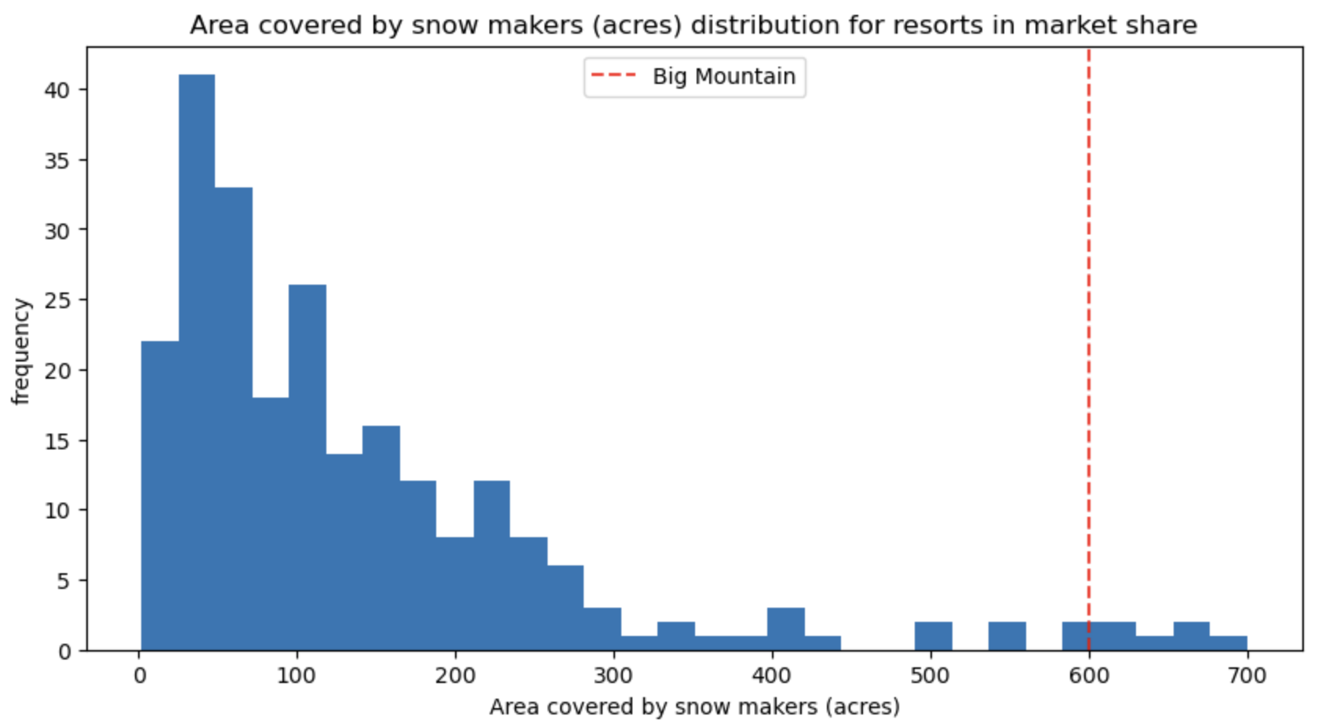
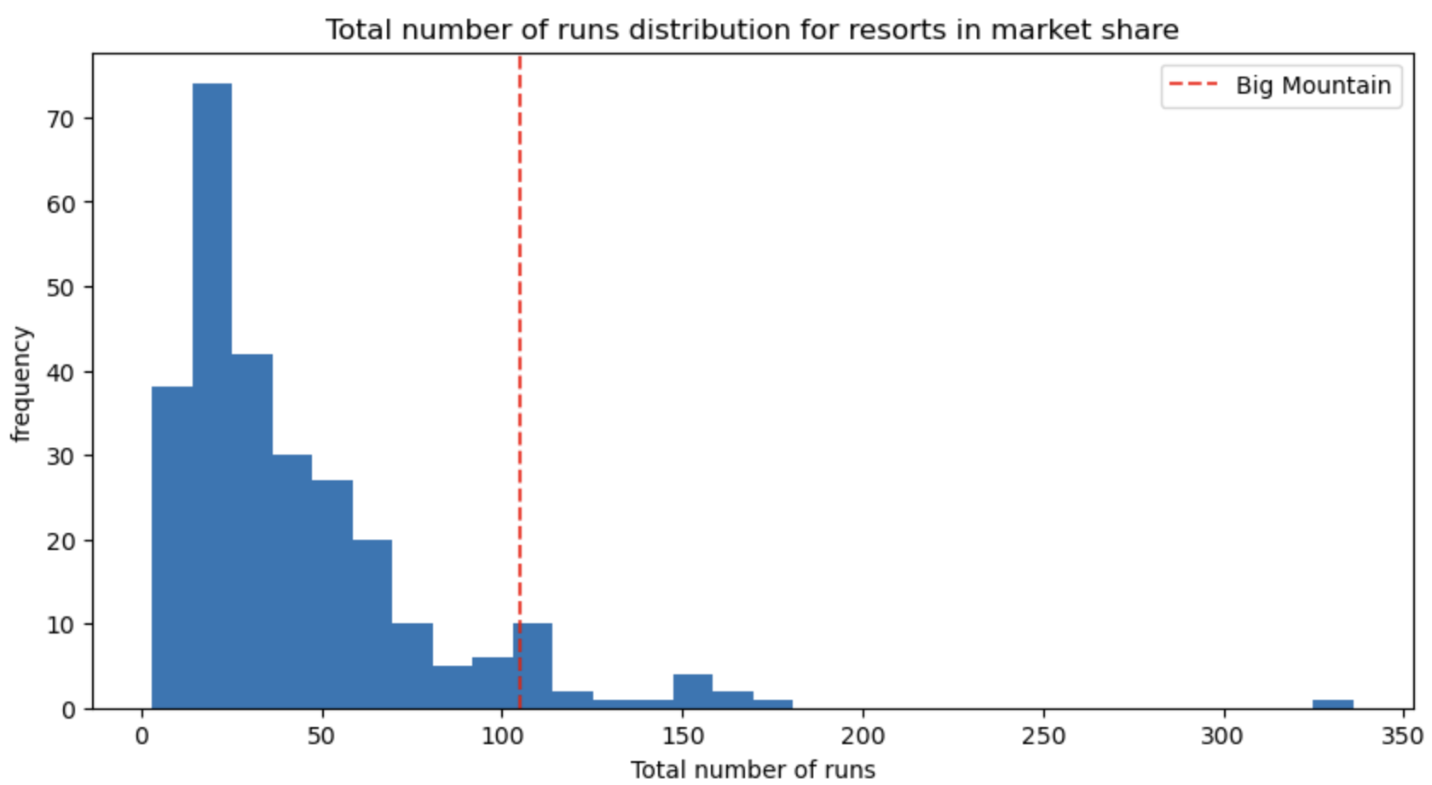
Price Vs Top Features
As we can see, Big Mountain is placed much higher on key features than it is on pricing. Showing potential for a price correction. From our analysis Big Mountain Resort modelled price is $95.87, compared to the actual price of $81.00.

Slide 4
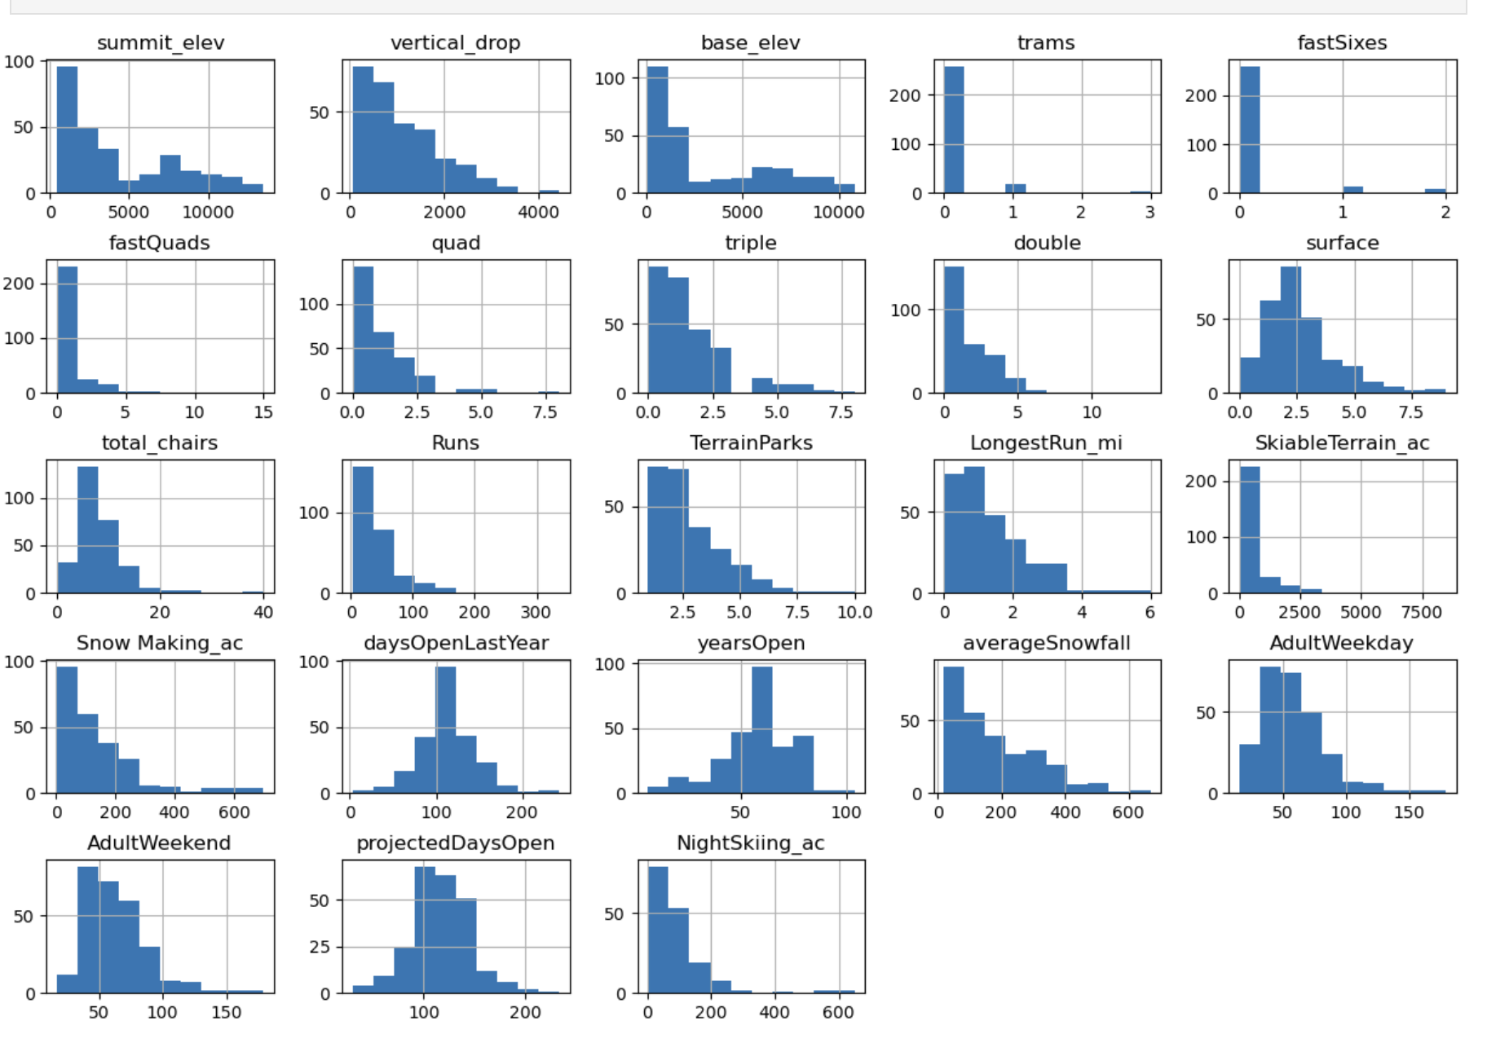
Data Modeling
Data used included all features except fastEights and the projected price was the Weekend ticket.
Data was cleaned up to remove or correct outliers or missing data to ensure all data followed a normal distribution.
At the end of the analysis, we compared the information from 276 resorts and used it to project the cost of the Weekend ticket for Big Mountain Resort.

Slide 5
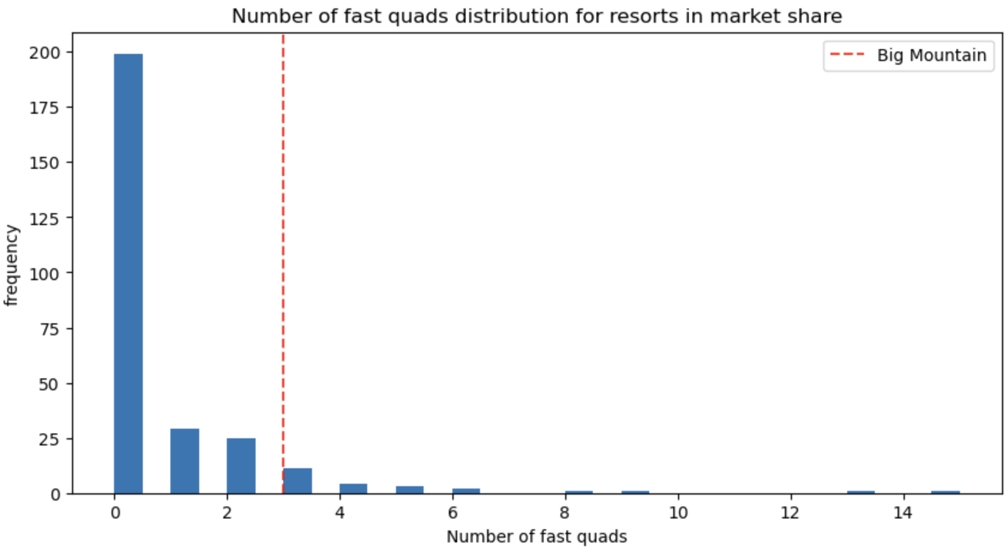
Model Used
The final model used was a random forest regressor with the key features being:
Fast Quads
Runs
Snow Making Acres
Vertical Drop

Slide 6
Summary and Conclusion
From this analysis, we recommend the executive team to implement the new pricing strategy and increase their ticket prices closer to the recommended $95.87. This would result in an increased revenue of over $5.2M without having to invest anything further.
It is important to call out that this model assumes the demand remains the same based on new prices. The next model I would recommend running would include the expected demand based on the features the resort can offer, so we can connect the increase in revenue per ticket with the actual changes in expected demand.

